Slide 1


Day 2:
Measuring what matters
Defining Success through Rubrics
UNM Evaluation Lab
2026 Summer Institute
9 June 2026

Slide 2
Before diving into the topic of rubrics…
- Evaluation on its own ≠ mission driven organizations.
- Rubrics fit into evaluation as part of the larger picture of formative assessment
  “assessment practices whose purpose is to improve practices, rather than judge them” SPH. Pg. 19
How do logic models and rubrics fit together in a formative assessment practice?

Slide 3
What are rubrics?
“A matrix that identifies criteria for success and describes levels of performance in relation to those criteria along a spectrum from poor to excellent.”
"Written descriptions of what success looks like”
David Grant. 2015. The Social Profit Handbook: The Essential Guide to Setting Goals, Assessing Outcomes, and Achieving Success for Mission-Driven Organizations. White River Junction, VT: Chelsea Green Publishing: p.45.​

Slide 4
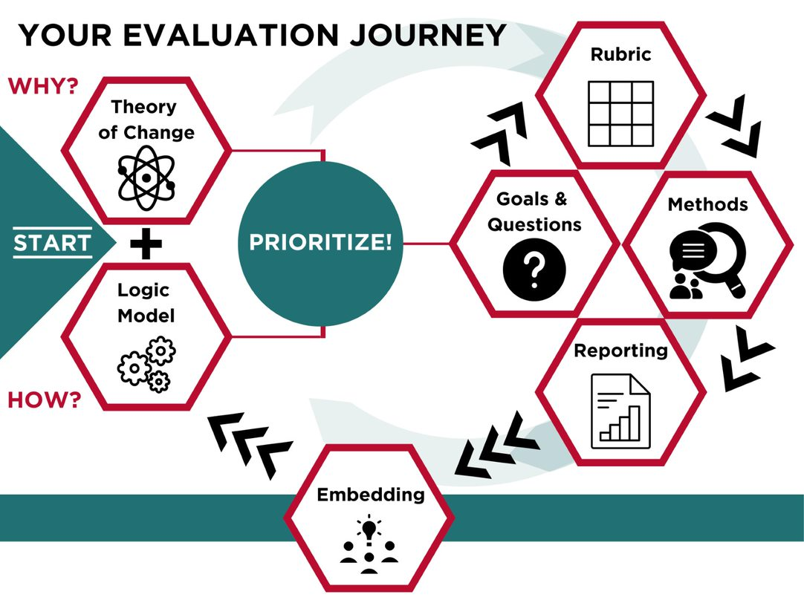
Rubrics help your organization build consensus on the definition of success.
You can use them for outputs and outcomes.

Slide 5
Rubrics are useful to define outputs and outcomes, especially those hard to measure - Examples
OUTPUTS
Quality of interactions between staff and participants
Welcoming environment
Developing trust
Sense of safety
OUTCOMES
Client self-agency
Emotional self-regulation
Healthy parent-child relationship
Cultural representation in product/service

Slide 6
Why?
As a core practice, rubrics get everyone on the same page, with a shared idea—and specific description—of success
A rubric gives you a tool to begin prioritizing to measure what matters to your organization.
It allows you to develop what is in your circle of influence

Slide 7
Circle of concern
Circle of influence
Circle
of
control
Circle of Concern concept adapted from Steven Covey, 7 Habits of Highly Effective People
Notes:
Being judged on something that is out of your control. Maybe you don’t have the skill. Maybe you don’t have the training. Maybe your influence is small relative to social forces.

Slide 8
Step 1:
Choose an output or outcome or value
Heart-Centered Approach
Interactions with clients are genuinely hopeful, welcoming, respectful, nonjudgmental, positive and validating
Responsiveness & adaptability allows us to meet people where they are, help them build on their strengths and support the capacity to cope in their journey to heal past trauma

Slide 9
Step 2: Name your levels of success
Level 1 |  | Level 2 |  | Level 3 |  | Level 4
Emerging | ➔ | Developing | ➔ | Achieving | ➔ | Extending
Novice | ➔ | Apprentice | ➔ | Master | ➔ | Expert
Whack | ➔ | Chill | ➔ | Lit | ➔ | Fire
Failed | ➔ | Survived | ➔ | Succeeded | ➔ | Thrived
Below standard | ➔ | Developing | ➔ | At standard | ➔ | Above standard
Not happening at all | ➔ | Happening a little | ➔ | Happening pretty darn good | ➔ | Awesomely happening
Notes:
Here are some examples of words other groups have used.

Slide 10
Step 3:
Describe levels 1-3, based on experience
Level 1 is the worst possible scenario you have seen or worry that could happen
Level 3 should be the best you have seen in your organization
(Tip: start with level 3 and 1, then 2)

Slide 11
Step 4:
Aspire!
Level 4 is what going beyond the best you have seen
Aspirational

Slide 13
In short: Using rubrics for evaluation will:
Give you concrete, specific descriptions for levels of success
  Use rubrics to evaluate your outputs, outcomes, values
Provide the context to give and receive feedback.
Frame evaluation as a function of our organizational priorities, not the evaluation tools.
Be an archive or record of what matters to our organizations. We can come back to them to guide our Mission Time.
Describe your aspirational level of success. Level 4 gives you something to strive for.
  Once you have described it, you will begin to figure out ways to achieve it

Slide 14
Questions?

Slide 15
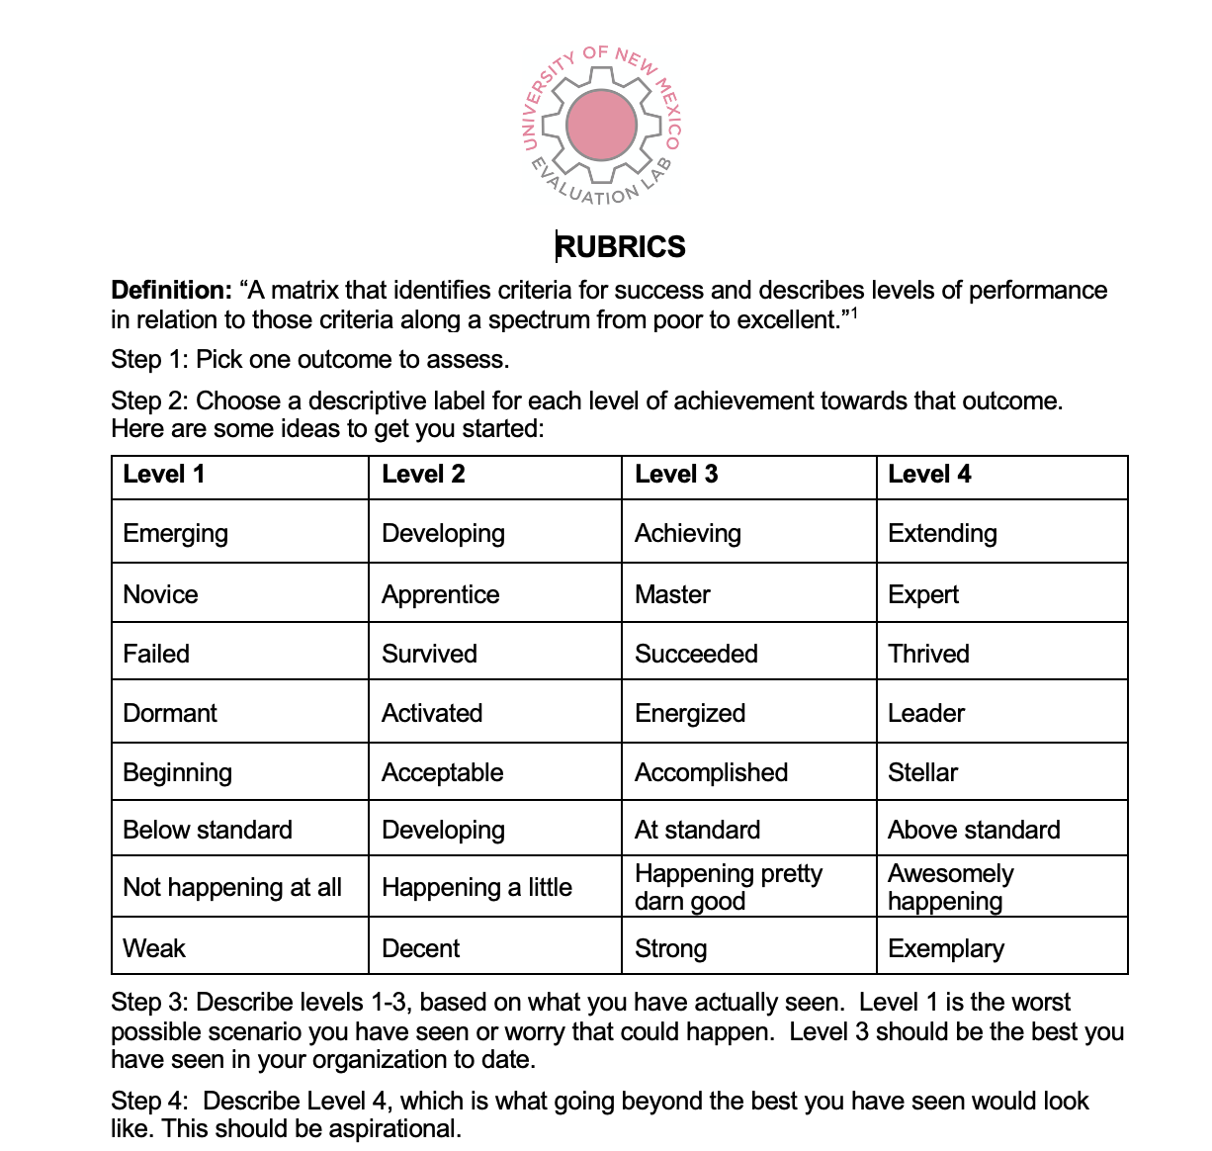
Rubrics guide

Slide 16
Additional Rubric Example
David Grant, the author of the Social Profit Handbook, served as director of the Dodge Foundation in New Jersey for several years.
The organization identified site Program Officers’ visits to partners as one of the most important components of their evaluation process. The rubric contains their four levels of success for these visits.

Slide 17
The Social Profit Handbook
Rubric 7.7: Dodge Foundation Site Visit Rubric
Quality of Visit and Conversation
1 Poor, Unacceptable | 2 Okay, Acceptable
Program officer: Conveys aura of mystery about what we do and how we do it. Asks questions they have already answered in the proposal. Lets frustrations come out when things are not going well with the organization. Takes no notes and leaves the visit with no specific information. Takes a cell phone call in the middle of the visit. Loses sight of grantor/grantee relationship. | Program officer: Goes to them, at their convenience, on time, with appropriate attire. Has informed conversation about the proposal and lets them know when they will hear from us. Asks if they have any questions for us.

Slide 18
The Social Profit Handbook
Rubric 7.7: Dodge Foundation Site Visit Rubric
Quality of Visit and Conversation, continued
3 Our Standard: Respect for Grantees | 4 Our Goal: Exceeding the Standard
Program officer: Places the visit in a context: The past relationship is known and valued. Asks the right questions of the right people; knows who does what and who thinks about what. Is aware of life-cycle issues, does not have the same conversation year after year. Is clear about the process: when things happen, how many groups are being considered, when and how grantee can still communicate with us, etc. Recognizes the value of grantee’s time Expresses appreciation for grantee’s work, regardless of outcome of specific grant proposal. Takes notes sufficient enough to inform write-up, but not so much as to not be fully present in the conversation (Wait a minute. That’s great. I need to write that down.) Clearly maintains the balance between the social and the professional. Gives even more time to groups likely to be declined, so they know they have been heard. | Program officer: Intervenes and significantly changes the conversations for the better by getting to the important things that need to be said. Acts as a resource, or consultant: connects groups to others in a helpful way; helps brainstorm about the future in a productive way. Notes impressions and body language, asks What are they trying to convey to me?

