Slide 1
Evaluation
Logic Model, Rubrics & Data collection tools

Slide 2
WHY IS IT GREAT TO HAVE A LOGIC MODEL??
If developed and reviewed regularly, it gets everyone on the same page, and working together
It provides a roadmap for designing evaluation activities that can help you assess your progress and success and inform plans for increasing effectiveness.

Slide 3
Logic Model
Components:
Resources/inputs
Activities
Outputs
Outcomes (short & long term)

Slide 4
Resources & Inputs
The things and people that you need to operate your program:
Gallery space
Grants and donations
Dedicated staff
Trainings, etc.

Slide 5
Activities
What you are doing when your program is happening
Classes
Counseling
Home visits
Events
Etc

Slide 6
Outputs
Observable things that the activities produce:
# of participants
# of events
# of sessions held
# of meals served
# of risk assessments, etc
*Outputs are the evidence that you did what you had planned to do
Notes:
A good way to know for sure whether something is an output vs. an outcome is to ask this question:
"Can I prove that this happened due to an activity we did, and not because of something else?"
If the answer is yes (such as, you are holding survey results in your hand that came from the survey you administered), it is an output.
If the answer is no (such as, your coworkers reported better job morale in a follow-up survey)… it is an outcome.

Slide 7
Outcomes
Changes in participant’s:
behavior
knowledge
Skills
level of functioning
Outlook
life trajectories.
Are the evidence that your program is having the hoped-for success in making a difference
Notes:
Consider what behavior or decision making changes you expect the targeted community/audience to make after participation

Slide 8
Short-term Outcomes:
What you want to see for a participant on the day he or she completes your program
Long-term Outcomes:
What you hope participants take with them into the future
*Create outcomes that are in your sphere of influence. You need to be willing to be held accountable for your outcomes
Notes:
Make sure we are collecting the appropriate data to measure what matters to our program

Slide 9
Assumptions & External Factors
Assumptions
Anything that needs to be true for your program to work.
Why you think your program will lead to the desired outcomes
*Assumptions are strongest when they are backed by evidence in the academic literature
External Factors
Comprise the setting in which your program operates
Some external factors may make the hoped-for outcomes more likely
Other external factors may impede your program’s success
Notes:
Assumptions- Logic Model assumptions should have support (Usually when building a logic model for a program one would’ve researched evidence-based programs that will be used or researched the topic)
Example of an assumption: Maybe your program rests on the assumption that people are capable of change once they recognize their triggers and learn self-regulation skills.
Assumptions for a program trying to decrease childhood obesity might include:
Nutrition education impacts obesity levels
Residents want information about healthy eating

Slide 10
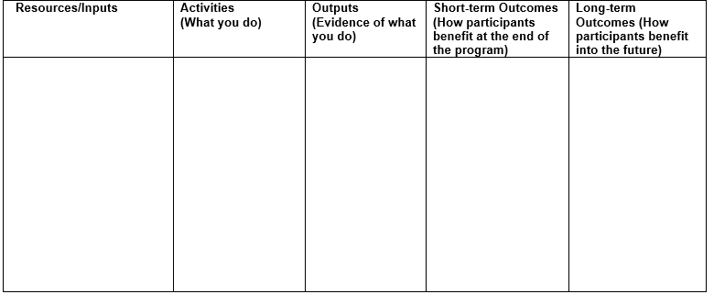
Logic Model

Slide 11
Rubrics
Used to describe what success looks like by describing levels of performance in relation to criteria along a spectrum from poor to excellent
Create a Rubric for each Short-term Outcome
Name levels of achievement
Describe each level
*Rubrics take time, dedication and commitment. Time spent developing a rubric increases commitment and ownership by staff

Slide 12
Name levels of achievement towards that outcome
Level 1 | Level 2 | Level 3 | Level 4
Emerging | Developing | Achieving | Extending
Novice | Apprentice | Master | Expert
Failed | Survived | Succeeded | Thrived
Dormant | Activated | Energized | Leader
Beginning | Acceptable | Accomplished | Stellar
Below standard | Developing | At standard | Above standard
Not happening at all | Happening a little | Happening pretty darn good | Awesomely happening
Weak | Decent | Strong | Exemplary
Notes:
The highlighted options fit in with our quarterly department evaluation so it might be easier to understand

Slide 13
Nuestra Vida SAMPLE Rubric
Outcome: By completion of the program, participants increase knowledge of how to manage their diabetes
Level 1 | Level 2 | Level 3 | Level 4
Basic | Decent | Strong | Excellent
Participants attend classes but not consistent Data doesn’t reflect purpose of intended outcome Facilitator does not follow fidelity of the curriculum No new registered participants | Participants attend classes regularly but still not weekly Data is inconsistent in demonstrating an increase in knowledge based questions Facilitator is inconsistent with curriculum material Graduated participants start a support group | Participants attend classes consistently on a regular basis (attend all classes) Data is complete and represents a consistent increase in knowledge based questions Facilitator follows fidelity of the curriculum (strictly) Support group meets regularly Food Diaries/Log | Participants attend classes weekly and bring family/friends Data is accurate and represents a statistically significant increase in knowledge based questions Facilitator increases their own knowledge regularly to improve curriculum Support group facilitates classes for new participants

Slide 14
Who should be involved
The more people involved the better
Everyone with a contribution in the project’s outcome
Groups:
Create a better rubric, more ideas
Builds enthusiasm for evaluation
Builds enthusiasm for work of the organization

Slide 15
Data
Always consider types of data and ease of collection for each data source in general
Administrative records
Clinical assessments, tests already being used
Surveys
Interviews & focus groups
*Data tells us to what degree we are achieving meaningful and measurable outcomes
Notes:
If you want to make claims about outcomes, data needs to be representative
No need to reinvent the wheel!
Look for validated instruments that get at the outcome you want to measure
Established validated instruments, national survey, or research studies
Always think and consider how easy/hard it will be to collect data needed
Beware of low response rates
You want response rates of 80% or higher

Slide 16
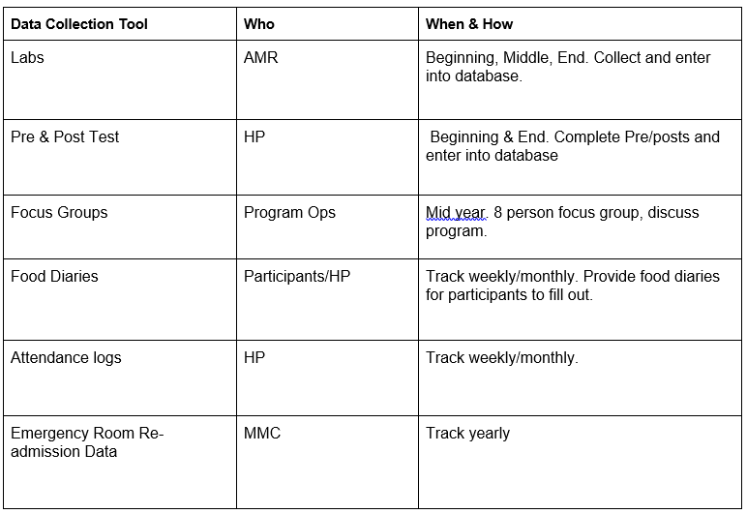
Data collection tools

Slide 17
Best Practices
Agree and set regularly scheduled time for staff to dedicate to Mission Time for development of Logic Model & Rubric
Review and refine your Logic Model as needed

Slide 18
Questions

