Slide 1


WELCOME
NM Early Childhood Organizations
Evaluation Learning Community
UNM Evaluation Lab Team
February 24, 2022

Slide 2
Zoom hacks
Please rename yourself, adding your organization
If you have a question, please type “Q” into the chat
  We will call on you after each section
  Please keep chat otherwise clear so we can keep track of questions
Try speaker view – it makes Zoom less distracting
Notes:
5 minutrd

Slide 3
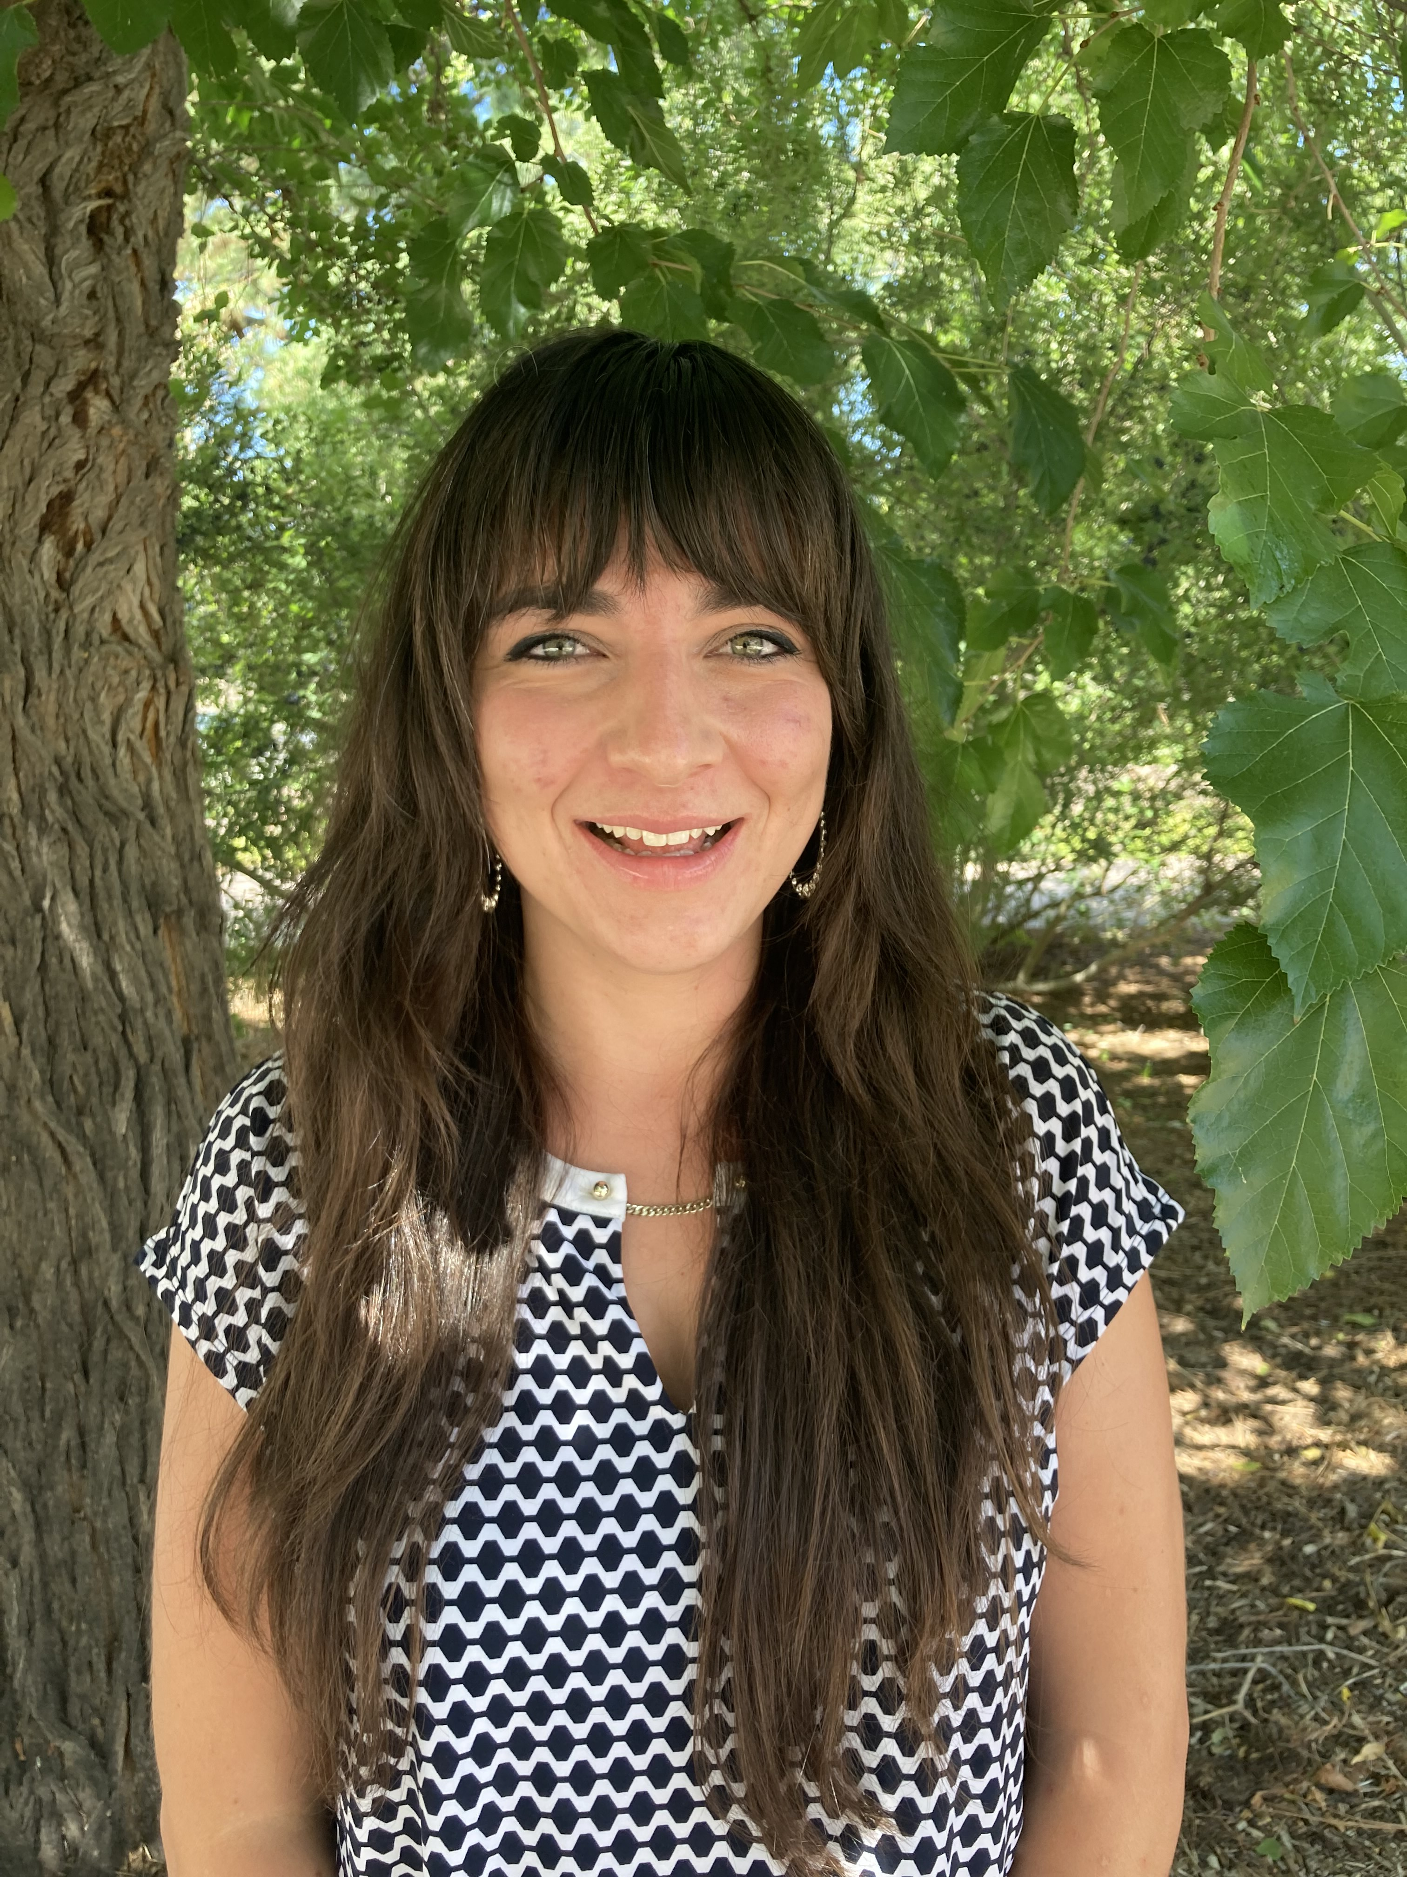

For help using Zoom
Have a question for the presenter?
Type “Q” in the chat.
Have Zoom questions?
Send a private chat to Caitlyn Moppert
Caitlyn Moppert
Logistics

Slide 4
Welcome Organizations!
Four Pueblos Home Visiting Program
Growing Up New Mexico
INSPIRE
La Esperanza Preschool
McKinley County Early Childhood Coalition
The Navajo Nation Division of Social Services
Navajo Family Voices
New Mexico Department of Health
Northwest New Mexico First Born
Pueblo of Pojoaque Early Childhood Center
Rehoboth Early Childhood Center
REEL FATHERS
Santa Fe Children's Museum
SFCC Early Childhood Center of Excellence
Twirl
UNM Family Development Program
Notes:
Setting aside time to do this work.
Hard to do in the hustle and bustle of doing your work.

Slide 5
Thank you, Brindle Foundation!

Slide 6
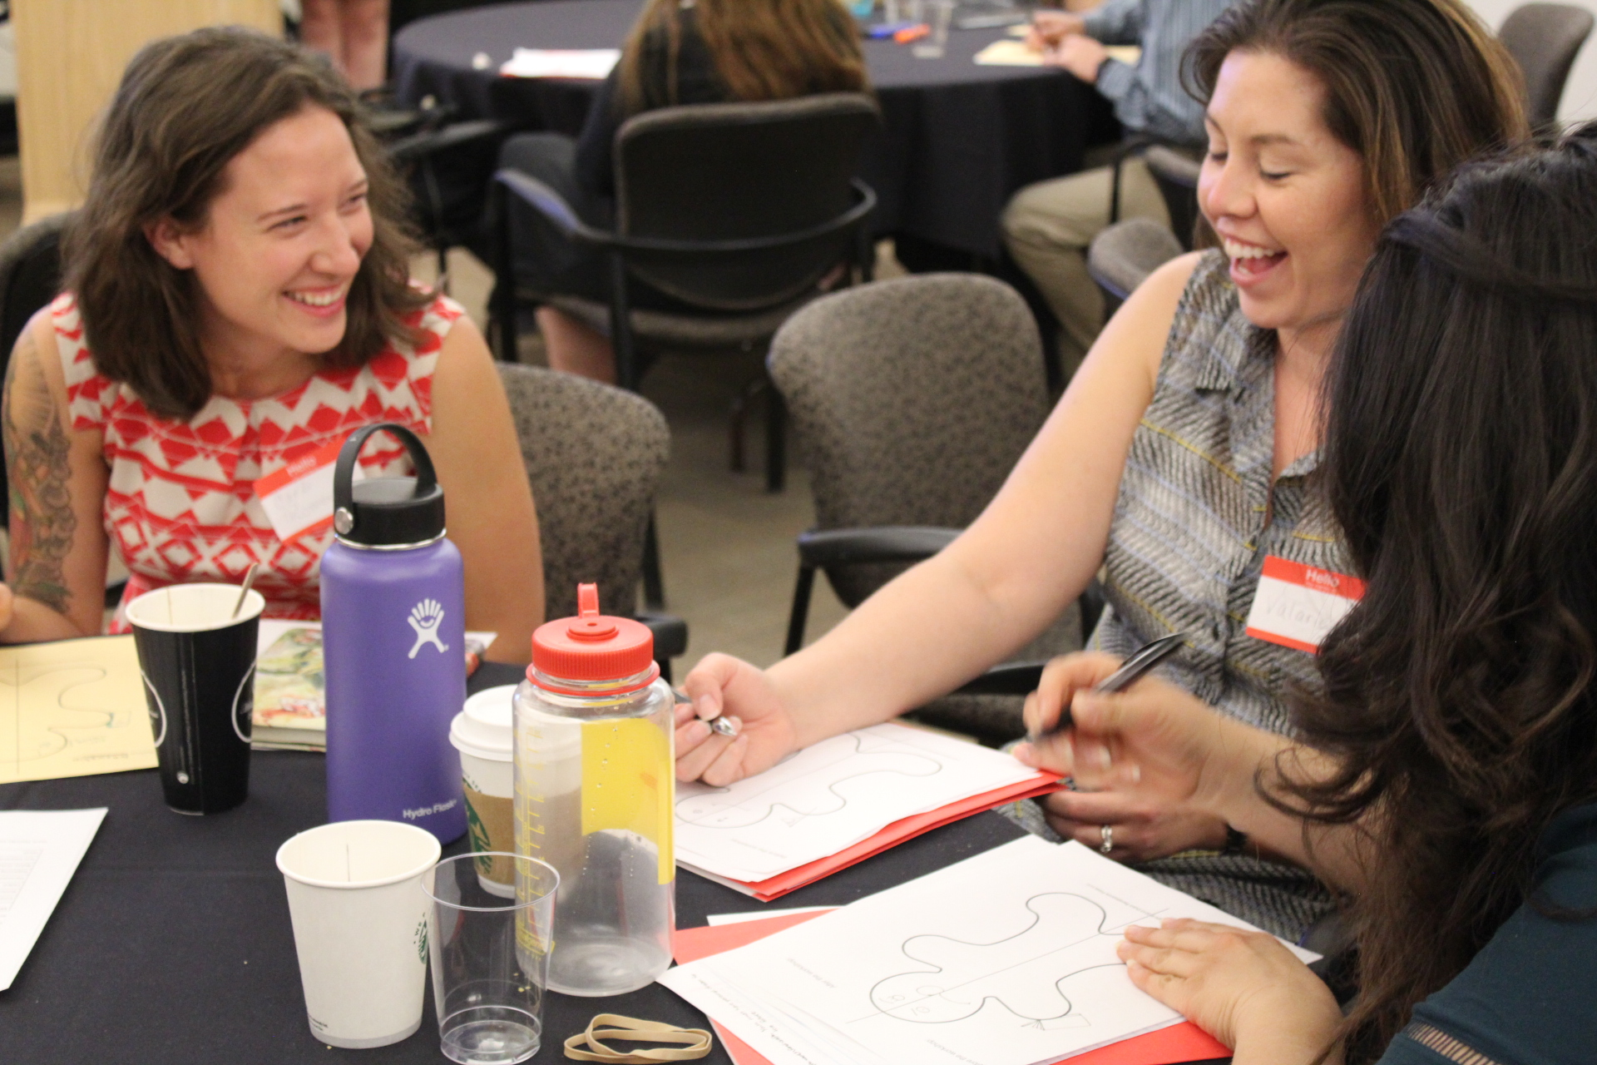
UNM Evaluation Lab
building evaluation capacity that is rooted in the needs of New Mexico’s communities.
Evaluation Lab Fellowship: student training in partnership with community organizations
Direct training and support for community organizations.
Notes:
Background: started with a pilot grant from Kellogg. Integrated into the new MPP program.

Slide 7



Evaluation Lab principles
measuring what matters
  and everything can be measured
embedded evaluation
  evaluation is part of the daily routine, and is used to achieve organization’s mission
participatory evaluation
  evaluation works best when lots of people representing lots of groups are involved: leadership, front-line staff, Board of Directors, participants (or former participants), community members

Slide 8

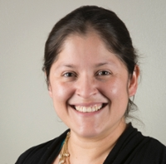
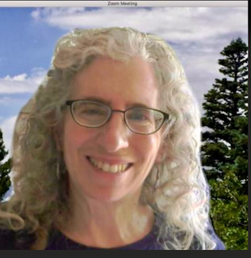
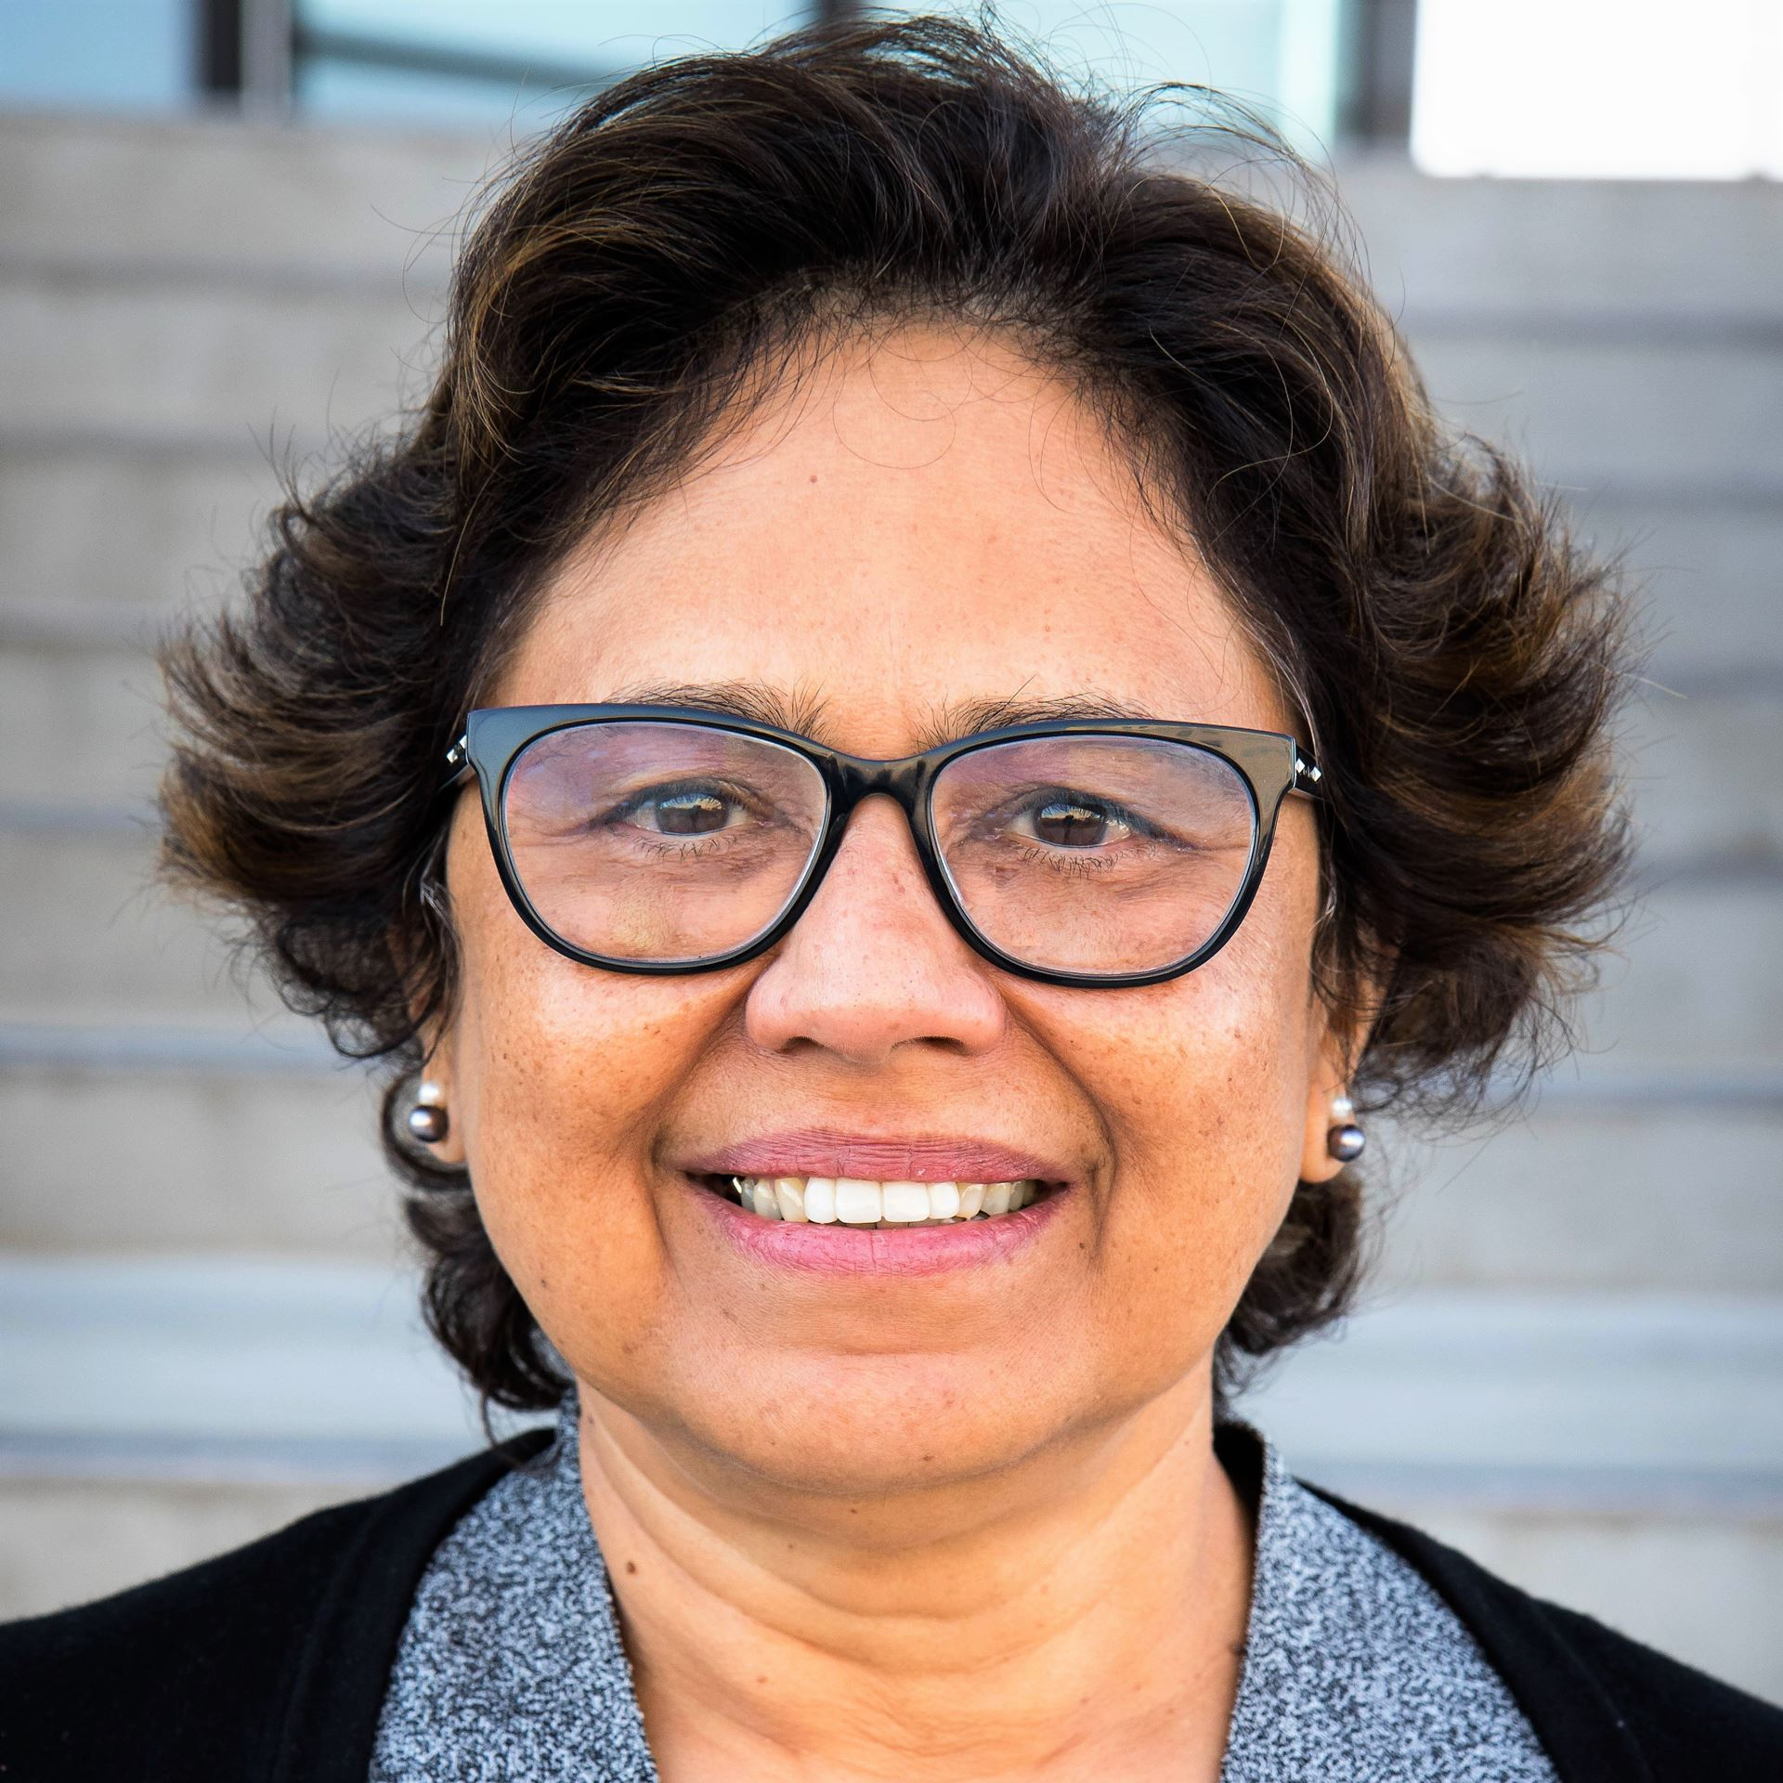
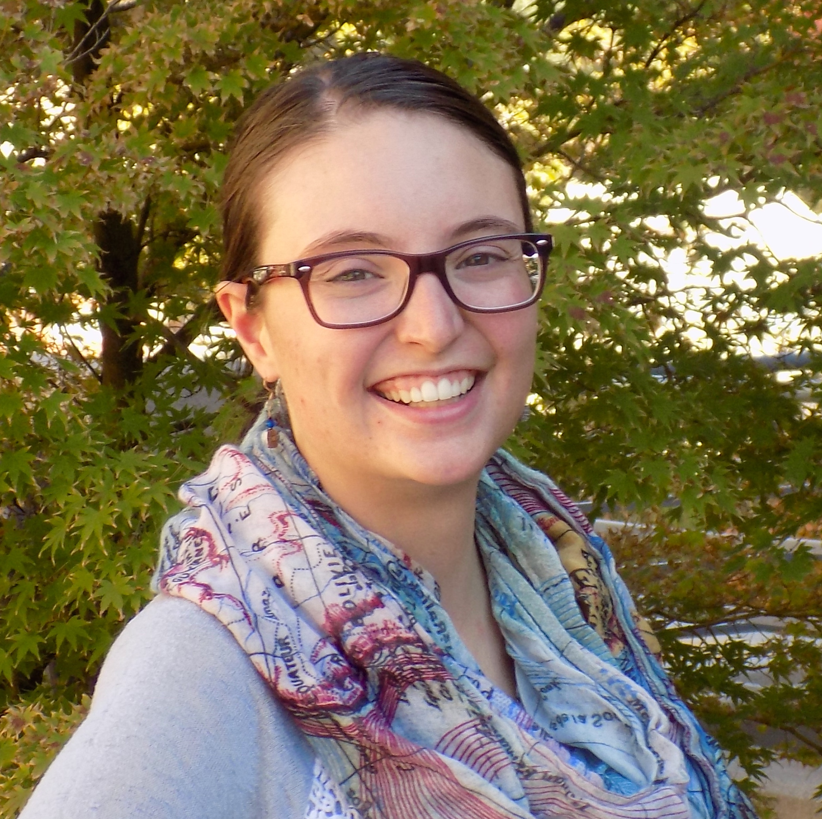
Facilitators
Camille
Claudia
Melissa
Ranjana
Velarde
Diaz Fuentes
Binder
Damle
ECHO Learning Community Director
Charla Orozco

Slide 9
The Learning Community
Today’s Orientation
  What is evaluation?
  Logic models as an evaluation guide
  Measuring what matters
One-on-One remote consultations with your facilitator
Evaluation Lab ECHO Learning Community
  One-on-one feedback from ECHO Learning Community facilitator
  Relationship building
  Peer learning
Other Resources
  http://evallab.unm.edu/for-organizations/new-mexico-early-childhood-evaluation-learning-community.html
Notes:
Caitlyn: Please share link in Chat!

Slide 10
One-on-One Consultations
First | March/April/May
Second | June/July/August
Third | September/October/November
Schedule first consultation today with your facilitator!!!

Slide 11
Consultations
We have technical expertise, you are the content experts
Possible topics:
  Your logic model
  Rubrics
  How to collect data
  Evaluation questions
  Survey review
Please share materials (if any) in advance

Slide 12

Evaluation Lab ECHO Online Learning Community 3rd Tuesdays, 9-10:30am
Everybody learning, everybody teaching
You will all be added to the listserv
Organizations share evaluation work in progress, get peer feedback
Didactics on a variety of evaluation topics
Sessions are recorded
https://evallab.unm.edu/learning-center/evaluation-lab-project-echo-learning-community-.html
Notes:
Developed for medicine, useful in all fields of practice.

Slide 13
ECHO Learning Community
3rd Tuesdays,9:00-10:30 AM
March 15 | Surveys
April 19 | Interactive Focus Groups
May 17 | Community-Based Participatory Evaluation
June 21 | Coding
July | BREAK
August 16 | Community Data
September 20 | Visualizing Data
October 18 | Excel: Pre-Post Reporting
November 15 | Excel: Advanced Topic
December | BREAK

Slide 14
Today’s Orientation
1:00-1:20pm | Welcome / Natural vs. Systematic evaluation
1:20-1:40pm | Small groups: Your experiences with natural evaluation, systematic evaluation
1:40-2:20pm | Debrief Elements systematic evaluation / Logic models
2:20-2:50pm | Logic model sandbox (on your own)
2:50-3:05pm | BREAK
3:05-3:25pm | Share work (groups)
3:25-3:50pm | Debrief Measuring what matters / Rubrics
3:50-4:20pm | Work on a rubric
4:20-4:50pm | Share work, sign up for first consultation (small groups with facilitator)
4:40-5:00pm | Debrief / What’s next
Blue = plenary
Purple = small groups
Green = take a break
Orange = work on your own

Slide 15
What is evaluation?
Seeing
Noticing what is working and not working
Adjusting our actions to make things work better

Slide 16
What is evaluation?
Collect & analyze data
Review data
Improve program
Seeing
Noticing
Adjusting

Slide 17
As humans, we are always doing evaluation!!!

Slide 18
Natural evaluation
Collect & analyze data
Review data
Improve program
We are always seeing (collecting data), noticing (reviewing data) and adjusting (program improvement)
Examples
Modifying a recipe
At work, you notice something didn’t work as expected and you decide to try something different

Slide 19
Systematic evaluation: taking your natural evaluation process, making it intentional, and putting it on a schedule!
Collect & analyze data
Review data
Improve program
Collect data at set times
Analyze data at set times
Review data in a meeting
Adjust program
Repeat

Slide 20
1:20-1:40pm Small groups
Your experiences with natural evaluation, systematic evaluation

Slide 21
Debrief

Slide 22
1:20-1:40pm | Small groups: Your experiences with natural evaluation, systematic evaluation
1:40-2:20pm | Debrief Elements systematic evaluation / Logic models
2:20-2:50pm | Logic model sandbox (on your own)
2:50-3:05pm | BREAK
3:05-3:25pm | Share work (groups)
3:25-3:50pm | Debrief Measuring what matters / Rubrics
3:50-4:20pm | Work on a rubric
4:20-4:50pm | Share work, sign up for first consultation (small groups with facilitator)
4:40-5:00pm | Debrief / What’s next
Blue = plenary
Purple = small groups
Green = take a break
Orange = work on your own

Slide 23
Elements of systematic evaluation
A logical model (a guide to what you want to track)
Rubrics (allow you to measure the seemingly intangible)
Data collection tools
  Intake and discharge (client characteristics and assessments)
  Surveys
  Focus groups
  Interviews
  Program artifacts
Review process
Today
Consultations,
ECHO Learning Community

Slide 24
Logic Models

Slide 25
If you already have a logic model

Slide 26
What is a Logic Model?
One-page description of your program that shows the connection between day-to-day activities, resources and your outcomes and mission
A chart, illustration or table
Living document!

Slide 27
Logic Models are AWESOME!!!!
SHARED VISION
  If developed or reviewed regularly by stakeholders, gets everyone on the same page and working together
ROAD MAP for Evaluation
  Tells you exactly what to track
  Provides guidance for how to become even more effective
COMMUNICATES your program succinctly to public and funders
LOGIC
  Helps you figure out if your program makes sense!

Slide 28
Logic Model components
A logic model will highlight and link:
Resources and inputs
  Activities
  Outputs
  Short- and long-term Outcomes
and articulate:
Assumptions – beliefs
External Factors – barriers
Notes:
Headings may be different depending on template you're using – but main components are same

Slide 29

Goal: Host a birthday party for a dear friend/family member.
Resources What you need | Activities What you do | Outputs Evidence that you did activities | Outcomes How your program affects participants
Resources – What you need | Activities – What you do | Outputs – What it looks like | Short-Term (at end of party) | Long-Term (in the future)
Host Birthday Person Venue/space Food & cake Tables & chairs Decorations Games Funding Music Piñata & candy | Eating Singing "happy birthday" and cutting the cake Opening gifts Beating the Piñata Dancing Playing games | # of guests who attend # of gifts (maybe) # of games available to guests % of food and cake eaten vs. left-over Engagement: # of people dancing, playing games Enthusiasm Atmosphere Welcoming Comfortable | The birthday person feels special & happy Attendees have a good time | The birthday person has a positive memory of your party The party makes a positive impact on guests – people use your party for ideas for their own parties
Assumptions: Culture – it's culturally appropriate to celebrate the way you've planned The birthday person WANTS to be celebrated (and celebrated in the way you've planned/organized) The resources you have and activities you've planned meet the preferences and needs of the guests |  |  | External Factors: COVID Food allergies/restrictions Maybe the day you've chosen is popular and there are several other events happening – guests will have to choose between your event and others Funding/space limitations or availability
Notes:
Note qualitative outputs and outcomes

Slide 30
Outcomes =
Changes in participant behavior
Knowledge
Skills
Level of functioning
Outlook
Life trajectories
Outcomes are the evidence that your program is making a difference.

Slide 31

Outcomes
Short-term Outcomes:
The birthday person feels special & happy
Attendees have a good time
Long-term Outcomes:
The birthday person has a positive memory of your party
The party makes a positive impact on guests – people use your party for ideas for their own parties
Short-term Outcomes:
What you want to see for a participant on the day he or she completes your program
Long-term Outcomes:
What you hope participants take with them into the future.
Notes:
Keeping in mind that Outcomes are the evidence that your program is having the desired success in making a difference.
Check to see if there are questions in chat.

Slide 32

Resources =
The things and people that you need to operate your program:
  • Space – for staff meetings, client meetings, storage, group activities, etc.
  • Funding – Grants and donations – Funding sources.
  • Staff – Administrative, operations, legal
  • Training – for new staff, certifications, licensing
  • Etc.
Host
Birthday Person
Venue/space
Food & cake
Tables & chairs
Decorations
Games
Funding
Music
Piñata & candy

Slide 33

Activities =
What you are doing when your program is happening:
  • Classes
  • Counseling
  • Home visits
  • Events
  • Etc.
Eating
Singing "happy birthday" and cutting the cake after blowing out the candles
Opening gifts
Beating the Piñata
Dancing
Playing games (yard games, board games, etc.)

Slide 34

Outputs =
# of guests
# of gifts (maybe)
# of games available to guests
% of food and cake eaten vs. left-over
Engagement:
  # of people dancing, playing games
  Enthusiasm
Atmosphere
  Welcoming
  Comfortable
  Activities happened!
  # of participants
  # of events
  # of meals served
  Engagement
  Trust built
Outputs are the evidence that you are doing what you planned to do.

Slide 35
Outputs versus outcomes
OUTPUTS:
You did your program!
OUTCOMES:
Your program made a difference!!
# of guests
# of gifts (maybe)
# of games available to guests
% of food and cake eaten vs. left-over
Engagement:
  # of people dancing, playing games
  Enthusiasm
Atmosphere
  Welcoming
  Comfortable
The birthday person feels special & happy
Attendees have a good time
The birthday person has a positive memory of your party
The party makes a positive impact on guests – people use your party for ideas for their own parties

Slide 36

Assumptions
Beliefs you have about what will work and why
Culture – it's culturally appropriate to celebrate the way you've planned
The birthday person WANTS to be celebrated (and celebrated in the way you've planned/organized)
The resources you have and activities you've planned meet the preferences and needs of the guests

Slide 37

External Factors – Barriers
What might limit or be an obstacle to success?
COVID -> must work around new (and changing) restrictions (social distancing, no groups of more than 5, comfort level of folks in attending events)
Maybe the birthday persons or guests have food allergies/restrictions that mean modifications or alterations to your menu
Maybe the day you've chosen is popular and there are several other events happening – guests will have to choose between your event and others
Funding/space limitations or availability

Slide 38
Goal: Host a birthday party for a dear friend/family member.
Resources What you need | Activities What you do | Outputs Evidence that you did activities | Outcomes How your program affects participants
Resources – What you need | Activities – What you do | Outputs – What it looks like | Short-Term (at end of party) | Long-Term (in the future)
Host Birthday Person Venue/space Food & cake Tables & chairs Decorations Games Funding Music Piñata & candy | Eating Singing "happy birthday" and cutting the cake Opening gifts Beating the Piñata Dancing Playing games | # of guests who attend # of gifts (maybe) # of games available to guests % of food and cake eaten vs. left-over Engagement: # of people dancing, playing games Enthusiasm Atmosphere Welcoming Comfortable | The birthday person feels special & happy Attendees have a good time | The birthday person has a positive memory of your party The party makes a positive impact on guests – people use your party for ideas for their own parties
Assumptions: Culture – it's culturally appropriate to celebrate the way you've planned The birthday person WANTS to be celebrated (and celebrated in the way you've planned/organized) The resources you have and activities you've planned meet the preferences and needs of the guests |  |  | External Factors: COVID Food allergies/restrictions Maybe the day you've chosen is popular and there are several other events happening – guests will have to choose between your event and others Funding/space limitations or availability
Notes:
Note qualitative outputs and outcomes

Slide 39
Logic model template
Inputs
Activities Outputs
Outcomes
Short Long
Assumptions
External Factors

Slide 40
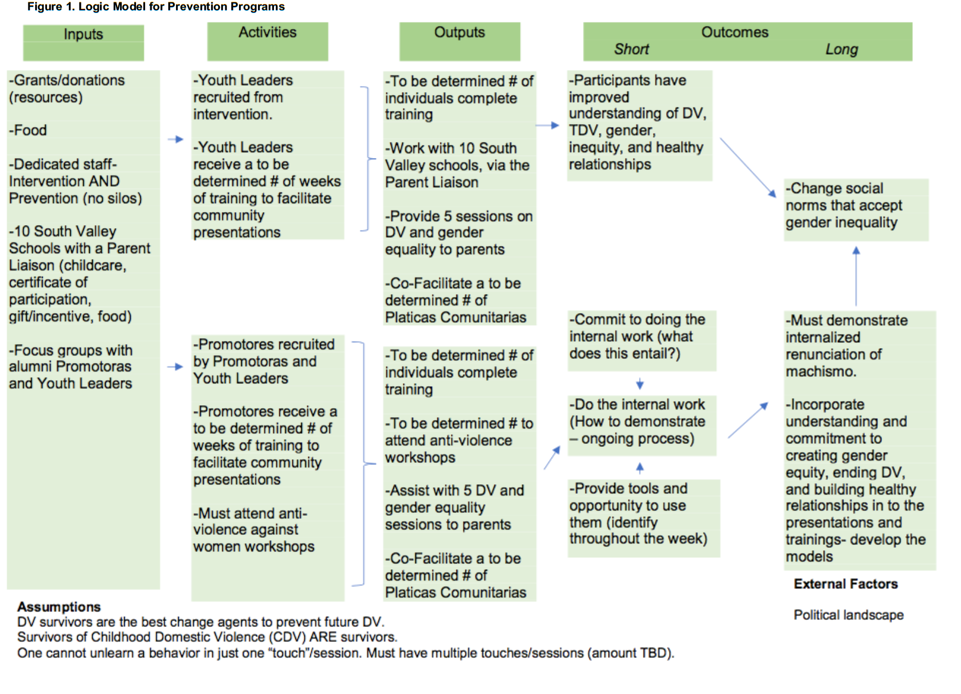
Logic Model from Enlace Comunitario

Slide 41
Logic model template
Resources/ Inputs | Activities | Outputs | Short-Term Outcomes | Long-Term Outcomes
Assumptions:
External Factors:

Slide 42
YOUTH ADVISORY COUNCIL
“The voice of Youth BLAST;” advocacy, leadership, research, service development & peer support
Youth leadership pathways
# of youth active in the council
Youth contributions to space, programs, policies, etc.
# of events & meetings attended to represent YB
RESOURCES
& INPUTS
Physical Space
Location supported by survey data
Furniture, Computers, Lockers. Kitchen, shower access
Donations
Internet Access
Staff and Partners
Youth Advisory Council
School partnerships
Bilingual staff (English & Spanish)
Clear purpose for youth involvement
Governmental support
Local and national consultation
Youth peer supports
Peer Support paid positions & structures of support for positions
Training resources
Bus passes
Community partnerships & resource coordination
YOUTH BLAST
OUTCOMES
OUTPUTS
Youth basic needs are met
Decrease in youth homelessness
Youth develop their own goals & path for future
Youth know their rights
Youth use their voice (strategic sharing, advocacy, peer support, language)
Young people given space to express & celebrate themselves
Paradigm for supporting young people is redefined
Model for youth-driven and community collaborative initiatives
Increase community’s understanding of young people's needs
Reduced stigma
Increased community involvement
Policy Change
Create networks/ communities of support
Improved sense of safety & belonging
Improved connectedness to peers, adults and community supports
Safety & Basic Needs
# of Youth Attending
# referred by other youth
Positive relationship & engagement
Supportive, inclusive & safe environment
# of youth connected to other support services
# participating in Youth BLAST activities
# of formal partners
# of monthly activities
# of peer supports
# of community meetings with Youth BLAST representation
Program evaluation plan informed and facilitated by young people.
Relationships
Mastery
Empowerment
Effective, youth-informed outreach
Non-judgmental, physically safe place; LGBTQI inclusive; no-discrimination
Case management
Distribution of basic necessities
Group meals
Bad guy/ creeper list
Safety planning
Harm reduction
Bus passes
Data tracking on youth needs
Nurtured Heart Approach
Therapeutic supports
Promoting positive culture (safety, belonging, inclusivity)
Games, social activities & events
Youth leadership opportunities
Trauma-informed routines & communication
Community building & engagement opportunities
Physical & artistic expression
life skill development
Resource & system navigation
Career exploration
Job development
Life skill coaching
STD Counseling/ testing / referral
Harm reduction
Legal rights knowledge & access to legal representation
Emotional literacy
Health & wellness practices
Youth Advisory Council
Paid Youth BLAST Peer Advocates
Internship opportunities
Youth BLAST represent-ation at community meetings
Access to a diversity of leadership opportunities
Community & coalition building; advocacy.
ASSUMPTIONS & VALUES: Young people have the power and capacity to be the author and hero of their own journey. A “one-stop-shop” model increases access for youth to engage in opportunities for their development. Creating a sense of safety, belonging and inclusivity lead to positive engagement and authentic relationships that are a catalyst for personal development and growth.
Youth BLAST PARTNERS
Shared vision; Clarity of expectations regarding partnership continuum; Mutuality & reciprocity of support; Cross training opportunities in core models, practices & knowledge; Regular Youth BLAST partnership and stakeholder meetings; Courageous conversations to keep strong/healthy partnerships; Partners represent Youth BLAST in community meetings; Processes for on-boarding new partnerships to support the collective

Slide 43
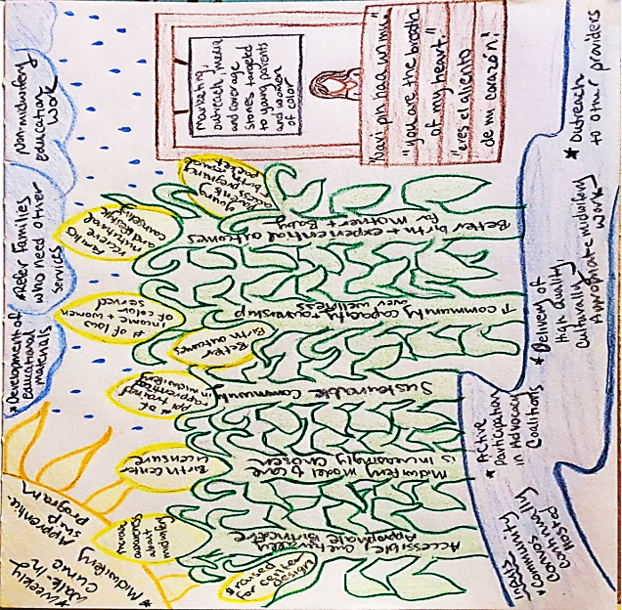

Slide 44
Getting started
Choose single program or whole organization
It’s helpful to complete the categories in this order:
  Outcomes
  Activities
  Outputs
  Resources
  Assumptions
  Barriers
Logic model guide
http://evallab.unm.edu/for-organizations/new-mexico-early-childhood-evaluation-learning-community.html

Slide 45
2:20-2:50pm | Logic model sandbox (on your own)
2:50-3:05pm | BREAK
3:05-3:25pm | Share work (groups)
3:25-3:50pm | Debrief Measuring what matters / Rubrics
3:50-4:20pm | Work on a rubric
4:20-4:50pm | Share work, sign up for first consultation (small groups with facilitator)
4:40-5:00pm | Debrief / What’s next
Blue = plenary
Purple = small groups
Green = take a break
Orange = work on your own

Slide 46
Rubrics

Slide 47
Rubric: Definition
“A matrix that identifies criteria for success and describes levels of performance in relation to those criteria along a spectrum from poor to excellent.”
“Written descriptions of what success looks like.”
  David Grant. 2015. The Social Profit Handbook: The Essential Guide to Setting Goals, Assessing Outcomes, and Achieving Success for Mission-Driven Organizations. (White River Junction, VT: Chelsea Green Publishing: p.45.)

Slide 48
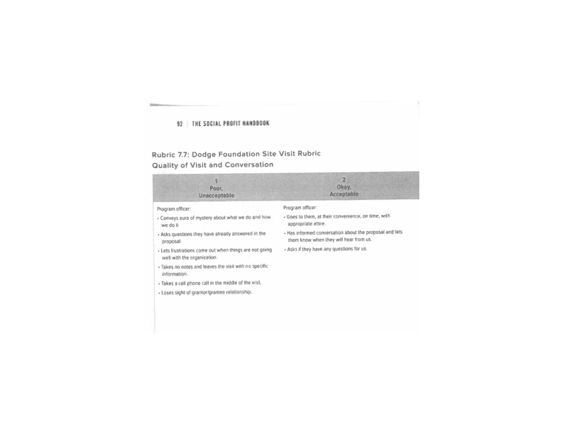
Performance rubric

Slide 49
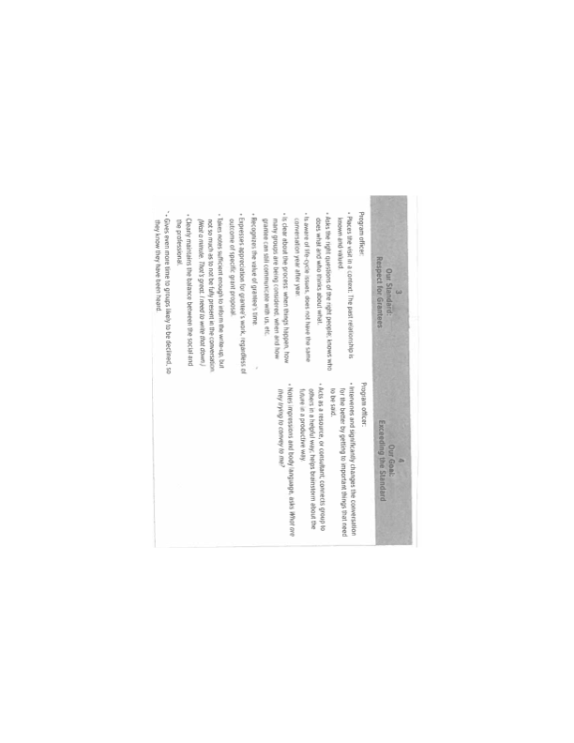

Slide 50
Why?
As a core practice, rubrics get everyone on the same page, with a shared idea—and specific description—of success
A rubric gives you a way to measure anything and everything
It allows you to develop what is in your circle of influence

Slide 51
Step 1:
Choose an output or outcome or value
Heart-Centered Approach
Interactions with clients are genuinely hopeful, welcoming, respectful, nonjudgmental, positive and validating
Responsiveness & adaptability allows us to meet people where they are, help them build on their strengths and support the capacity to cope in their journey to heal past trauma

Slide 52
Step 2: Name your levels of success
Level 1 |  | Level 2 |  | Level 3 |  | Level 4
Emerging | ➔ | Developing | ➔ | Achieving | ➔ | Extending
Novice | ➔ | Apprentice | ➔ | Master | ➔ | Expert
Whack | ➔ | Chill | ➔ | Lit | ➔ | Fire
Failed | ➔ | Survived | ➔ | Succeeded | ➔ | Thrived
Below standard | ➔ | Developing | ➔ | At standard | ➔ | Above standard
Not happening at all | ➔ | Happening a little | ➔ | Happening pretty darn good | ➔ | Awesomely happening
Notes:
Here are some examples of words other groups have used.

Slide 53
Step 3:
Describe levels 1-3, based on experience
Level 1 is the worst possible scenario you have seen or worry that could happen
Level 3 should be the best you have seen in your organization

Slide 54
Step 4:
Aspire!
Level 4 is what going beyond the best you have seen
Aspirational

Slide 56
Using rubrics
A rubric gives you concrete, specific descriptions for levels of success
  Use rubrics to evaluate your outputs, outcomes, values
Level 4 gives you something to strive for.
  Once you have described it, you will begin to figure out ways to achieve it

Slide 57
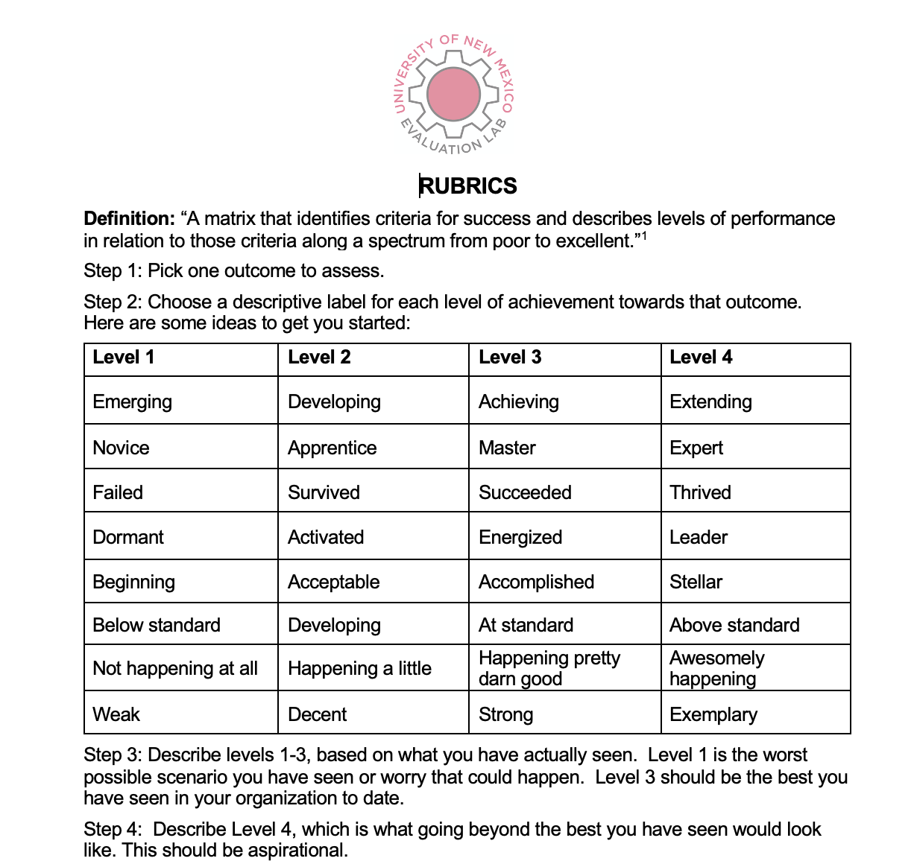
Rubrics guide
http://evallab.unm.edu/for-organizations/new-mexico-early-childhood-evaluation-learning-community.html

Slide 58
Try it!
Start a rubric for ONE outcome, output or value
http://evallab.unm.edu/for-organizations/new-mexico-early-childhood-evaluation-learning-community.html
Rubrics guide:

Slide 59
3:50-4:20pm | Work on a rubric
4:20-4:50pm | Share work, sign up for first consultation (small groups with facilitator)
4:40-5:00pm | Debrief / What’s next
Blue = plenary
Purple = small groups
Orange = work on your own

Slide 60
Evaluation Lab ECHO Online Learning Community 3rd Tuesdays, 9-10:30am
Everybody learning, everybody teaching
You will all be added to the listserv
Organizations share evaluation work in progress, get peer feedback
Didactics on a variety of evaluation topics
Sessions are recorded
https://evallab.unm.edu/learning-center/evaluation-lab-project-echo-learning-community-.html
Notes:
Developed for medicine, useful in all fields of practice.

Slide 61
ECHO Learning Community
3rd Tuesday, 9:00-10:30 AM
March 15 | Surveys
April 19 | Interactive Focus Groups
May 17 | Community-Based Participatory Evaluation
June 21 | Coding
July | BREAK
August 16 | Community Data
September 20 | Visualizing Data
October 18 | Excel: Pre-Post Reporting
November 15 | Excel: Advanced Topic
December | BREAK

Slide 62
Thank you and see you soon!

